Slide 1
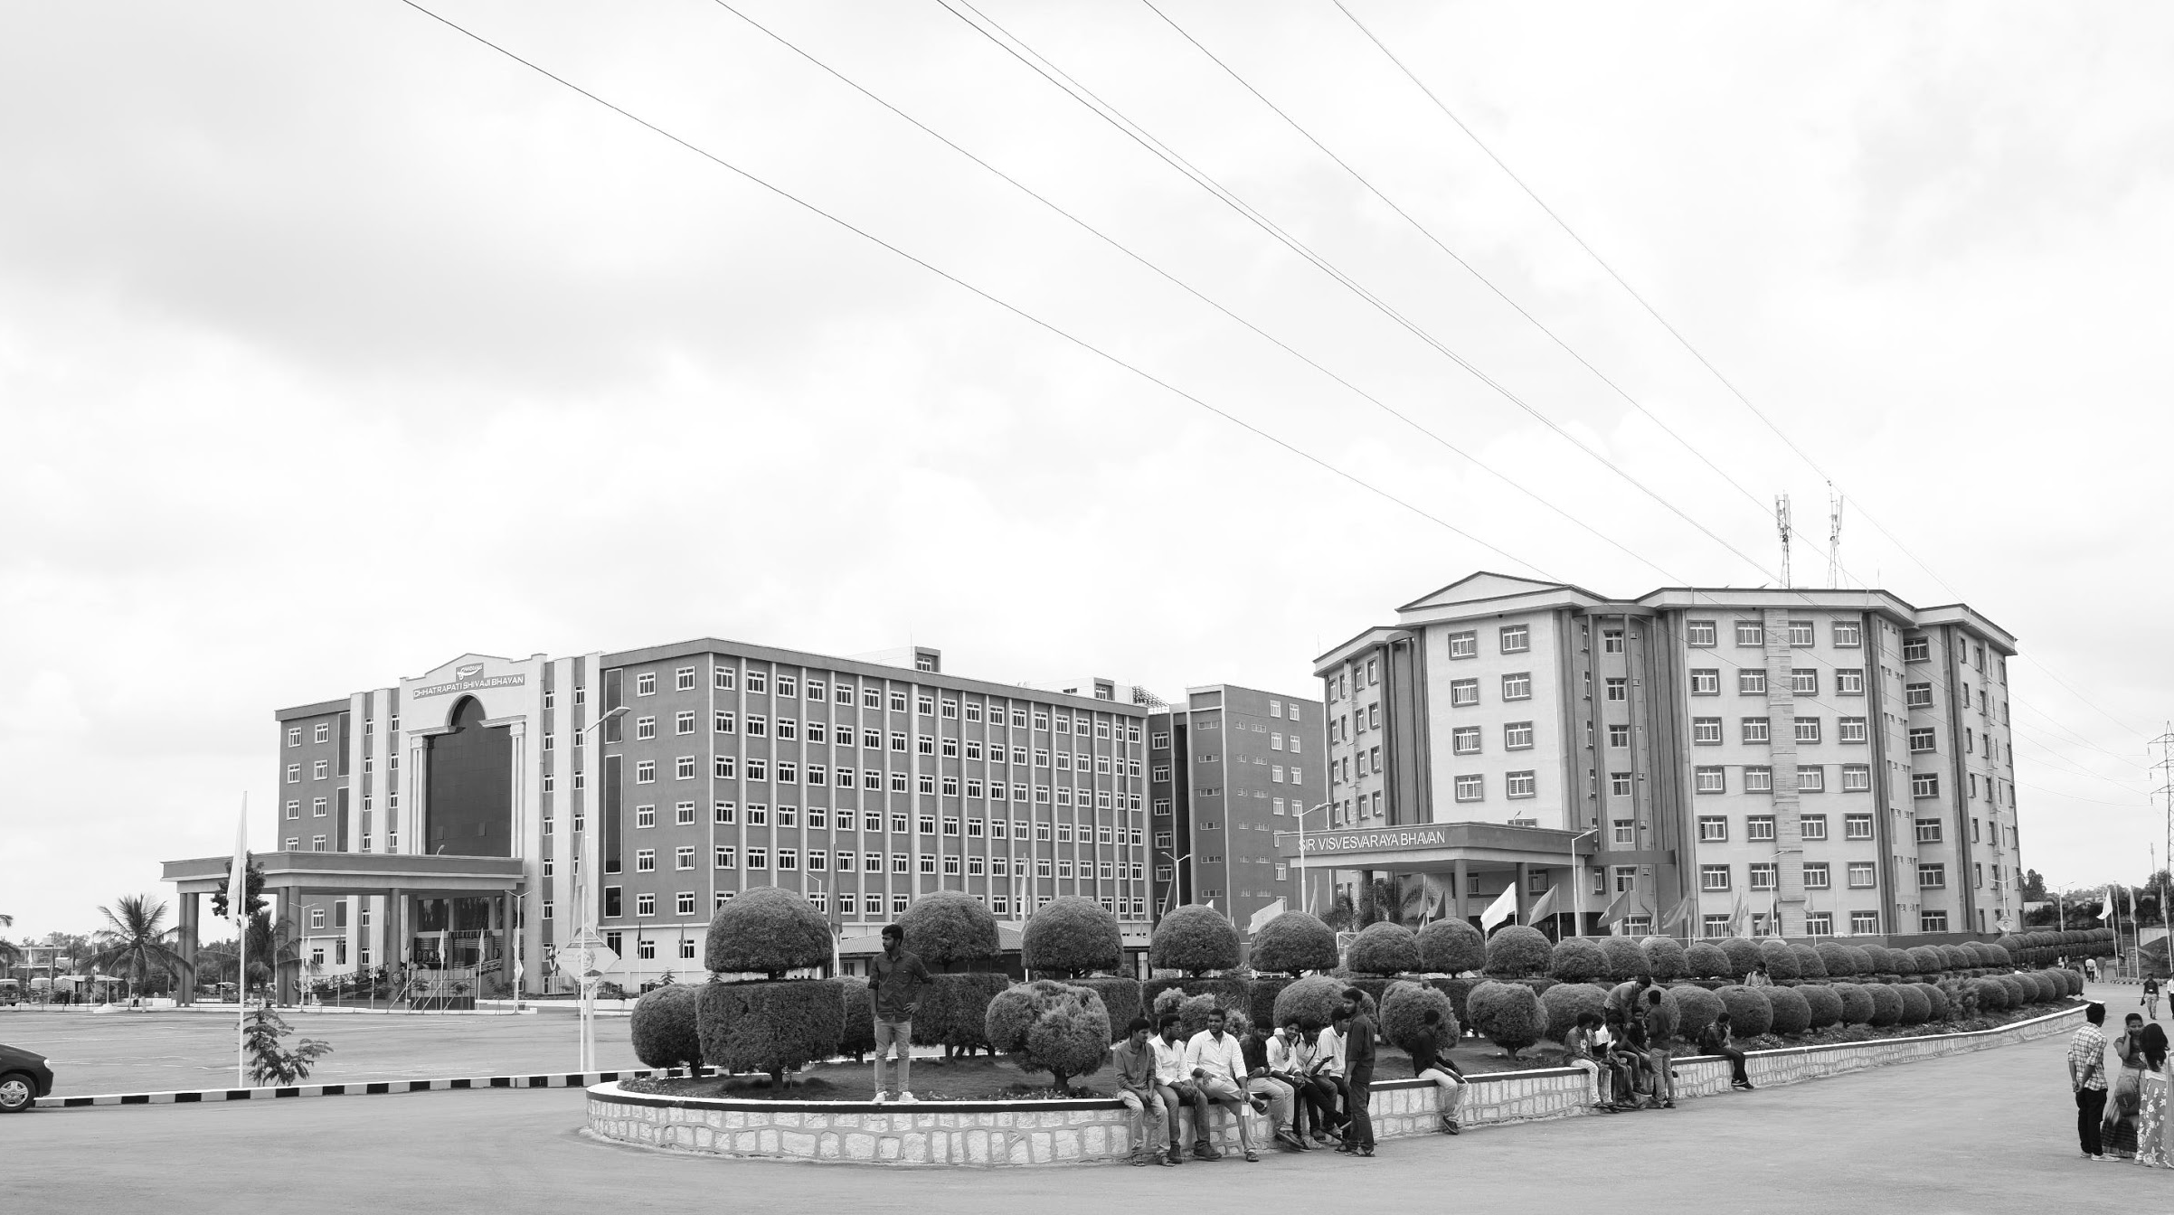

Land Region Monitoring for farming using Deep Learning
AY 2021-2025
GITAM UNIVERSITY
Major Project
Project ID: Alpha 8 & A-10
A University should be a place of light, of liberty, and of learning.
Department of Electrical Electronics and Communication Engineering
Project Team:
Ramireddygari Yaswanth Reddy (BU21EECE0100081)
Tadipathri Syed Faiz Ali (BU21EECE0100140)
Mallu Rameshwara Reddy (BU21EECE0100153)
Project Mentor:
Ms. Dioline Sara
www.gitamedu.com

Slide 2

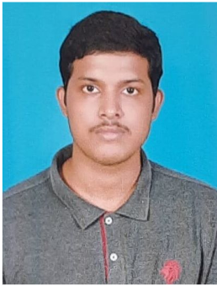
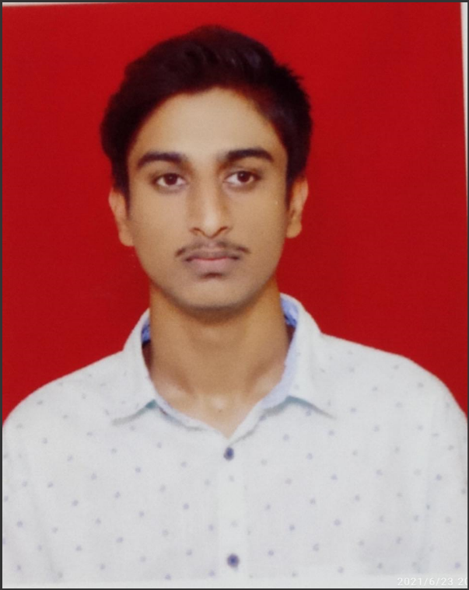
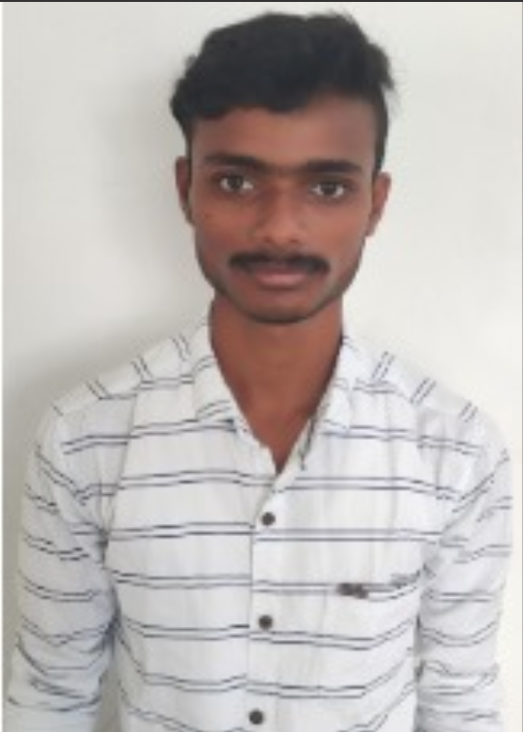
Project Group – Details
Photo
Track
Roll No
Name
EECE
BU21EECE0100081
Ramireddygari Yaswanth Reddy
EECE
BU21EECE0100140
Tadipathri Syed Faiz Ali
EECE
BU21EECE0100153
Mallu Rameshwara Reddy

Slide 3
Objective and Goals
Objective
To develop a software tool that can accurately classify different types of soil found in India using image processing and machine learning techniques, specifically Convolutional Neural Networks (CNNs).
Goals
Main Goals
Soil Classification: Achieve accurate classification of various soil types based on their physical and chemical properties using advanced image processing and feature extraction methods.
Additional Goals
Crop Recommendation: Provide farmers with scientifically-based recommendations for suitable crops based on the classified soil type, thereby aiding in decision-making and improving agricultural productivity.
User Accessibility: Ensure that the developed tool is user-friendly and accessible to farmers with minimal technical expertise, promoting widespread adoption.

Slide 4
Project Plan
Phase | Week 1-2 | Week 3-4 | Week 5-6 | Week 7-10 | Week 11-12
Problem Definition & Literature Survey | ✔
Data Collection & Preprocessing |  | ✔
Model Selection & Development |  |  | ✔
Model Training & Testing |  |  |  | ✔
Evaluation & Refinement |  |  |  |  | ✔

Slide 5
Abstract
The decreasing amount of agricultural land combined with a growing population has created a strong need for better farming styles. To address this, our project aims to develop a free software tool to help farmers identify soil types and compositions and recommend suitable crops and diseases. This software will concentrate on India, a country known for its different soil types similar as sandy, saline, alkaline,and calcareous soils. The application uses image processing techniques to accurately classify these various soil types. The system operates in three stages: low- level, medium- level, and high- level processing. The low- level stage involves introductory image enhancements and noise reduction. In the medium- level stage, features are extracted using transformation, autocorrelation, and HSV histograms. The high- level stage uses advanced classification algorithms to analyze the processed soil images and give accurate results. By analyzing soil images, the operation can determine the soil's type and nutrient content, and also recommend the best crops for it. This helps farmers make better decisions. Using convolutional neural network (CNN) techniques in the classification stage ensures the results are accurate and reliable. The application is designed to be user-friendly, providing essential information to farmers in an easily accessible way. This tool can significantly boost agricultural productivity, reduce costs, and improve the lives of farmers in India and potentially in other areas with different soil types. By integrating advanced image processing and classification techniques, the project aims to revolutionize farming styles and promote sustainable agricultural practices.

Slide 6
Introduction
This problem statement focuses on the urgent need to develop an advanced system capable of automatically identifying and analyzing various soil types and compositions to optimize agricultural practices.
By leveraging image processing, deep learning, and AI techniques, the system aims to classify soil types accurately and provide tailored recommendations for suitable crops.
This solution is particularly critical in a country like India, where diverse soil conditions significantly impact agricultural productivity.
By automating soil analysis and delivering precise recommendations, this system will empower farmers to make informed decisions, ultimately boosting crop yields, reducing costs, and promoting sustainable farming practices.
The integration of cutting-edge technology in agriculture not only enhances efficiency but also addresses the challenges of feeding a growing population in the face of shrinking arable land, making it a time-effective and transformative advancement in farming.

Slide 7
Hardware:
l. High-Resolution Camera
- 12 SIP or higher resolution
- Macro capabilities
2. Soil Moisture Sensor (Optional)
- Capacitive or resistive type
3. pH Sensor (Optional)
- Standard pH sensor with a 0-14 pH range
4.Temperature and Humidity Sensor(Optiona1)
- DHT11 or DHT22
5. Microcontrollers (If Using Sensors)
- Raspberry Pi 4
- OpenCV (for image processing)
- Numpy,Pandas (for data handling)
Software:
1. AI Model
- Convolutional Neural Network (CNN)
- TensorFlow or PyTorch framework
2. Image Processing Tools
- OpenCV for preprocessing (resizing, noise reduction: etc.)
- Data Augmentation Techniques (rotation: flipping: etc.)
3.Libraries
- TensorFlow or PyTorch (for Al model development)

Slide 8
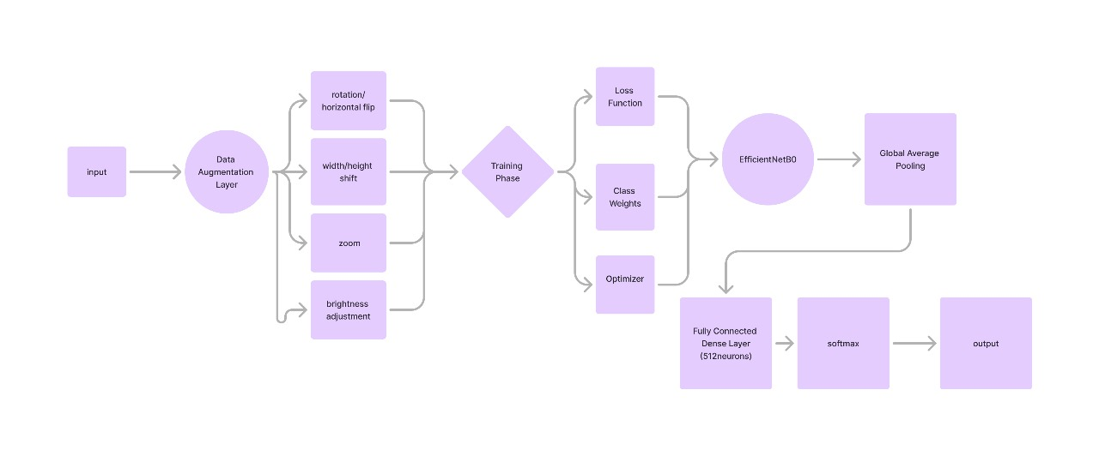
Methodology- Block Diagram

Slide 9
Literature Survey
Paper Title | Model | Methodology | Accuracy | Precision
Soil Classification and Suitable Crop Prediction | Gabor Filters and Law's Mask | Image acquisition, pre-processing, feature extraction (color and texture), classification using statistical measurements. | 96% | 96%
Application of Machine Vision for Classification of Tillage Quality | Artificial Neural Networks(ANN) | Uses RGB signals and image analysis for tillage quality classification. | 72.01% | 41.18% to 92.11%
A Novel Approach for Classification of Soils Based on Laboratory Analysis | Not Explicitly Mentioned | Laboratory analysis-based classification, possibly machine learning-based. | 80% | 54% to 75%
Smartphone-Based Soil Color Sensor | Linear Discriminant Analysis (LDA) | Utilizes RGB values from smartphone sensors to classify soil color. | 90% | 83.5%

Slide 10
Paper Title | Model | Methodology | Accuracy | Precision
Soil texture classification using multi class support | Multi-class SVM | SVM with linear kernel applied to HSV histogram Gabor wavelets, Discrete Wavelet Transform, etc. | 91.37% | 83%
Soil classification using machine learning methods | Gaussian SVM, kNN, Bagged Trees | SVM (Gaussian kernel). Weighted kNN, Bagged Tree ensemble | 94.95% | 56% to 80%
Classification of agricultural soil parameters in India | Random Forest, SVM | SVM with Gaussian kernel, Random Forest classifier implemented with Cohen's kappa measure | 95.8% | 86%
Improving the Prediction Accuracy of Soil Nutrient Classification | Extreme Learning Machine (ELM) | ELM with activation functions (Gaussian radial basis, hyperbolic tangent, triangular basis, hard limit, sine-squared) | 90% for P-F | 90% for K-F

Slide 11
Analysis - SWOT
Strengths
Weaknesses
1.Advanced Technology Integration: High accuracy in soil classification through AI and deep learning.
2.User-Friendly Design: Accessible to farmers with limited technical skills.
3.Cost-Effective Solution: Free tool that reduces input costs and boosts crop yields.
Dependence on Image Quality: Accuracy hinges on the quality of soil images.
Limited Regional Focus: Primarily tailored to Indian soil conditions.
Need for Technical Support: Some users may require assistance with setup and troubleshooting.
Opportunities
Threats
Competition: Emerging agricultural technologies could limit adoption.
Technological Barriers: Limited access to necessary hardware in rural areas.
Data Privacy Concerns: Potential issues with data collection and usage might affect user trust.
Scalability to Other Regions: Potential for adaptation to global agricultural practices.
Expansion of Features: Opportunity to integrate additional functions like pest detection.
Partnerships with Agricultural Agencies: Collaboration with government and NGOs for broader reach.

Slide 12
Analysis - 4W1H
Why: The decreasing availability of agricultural land and the need for efficient farming practices necessitate a tool that can accurately analyze soil types and recommend suitable crops to optimize productivity.
What: A software tool that uses image processing and AI to classify soil types and provide tailored crop recommendations to farmers.
Where: Primarily in India, where diverse soil types significantly influence agricultural output, with potential expansion to other regions.
When: The tool is intended for immediate use to address current agricultural challenges and can be continually updated as technology advances.
How: By utilizing advanced image processing techniques, deep learning models, and a user-friendly interface, the software analyzes soil images to determine type, composition, and suitable agricultural practices.
Refined Objective: To develop and deploy a free, accurate, and easy-to-use software tool that empowers farmers by providing real-time soil analysis and crop recommendations, thereby enhancing agricultural productivity and sustainability.

Slide 13
Implementation and Results – Iteration 1
For Epoch=10
Model Name | Accuracy (%) | Precision (%) | Recall (%)
ResNet50 | 29.92% | 17.37% | 29.92%
ResNet 101 | 28.41% | 22.01% | 28.41%
DenseNet 201 | 21.59% | 21.77% | 21.59%
InceptionV3 | 25.76% | 25.67% | 25.76%
VGG16 | 43.61% | 41.15% | 43.61%

Slide 14
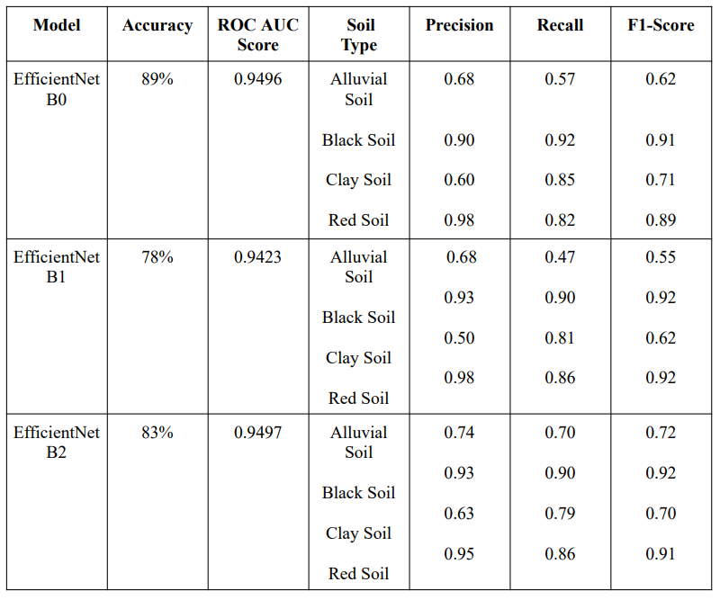
Implementation and Results – Iteration 2

Slide 15
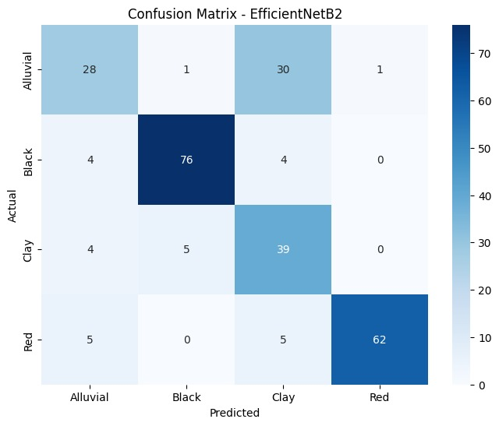
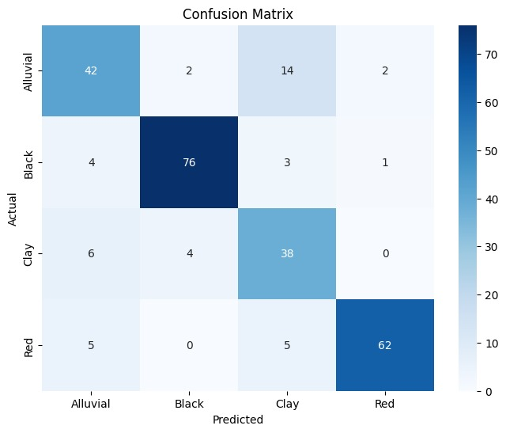
Implementation and Results – Iteration 2

Slide 16
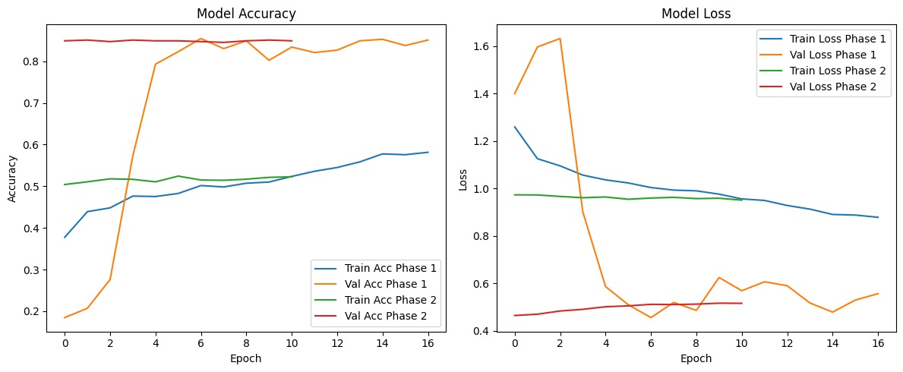
Implementation and Results – Iteration 2

Slide 17
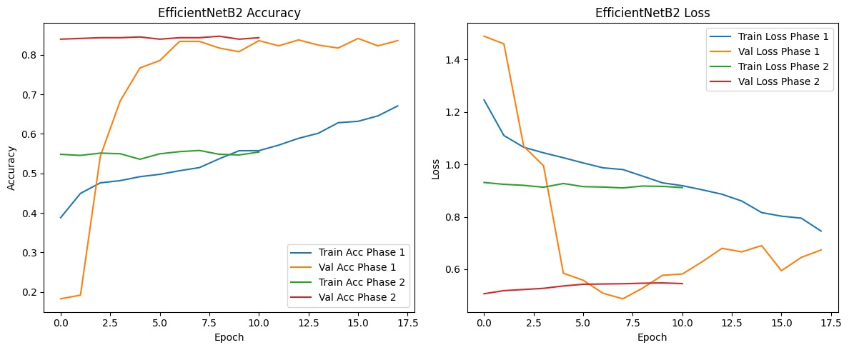
Implementation and Results – Iteration 2

Slide 18
Implementation and Results – Iteration 2

Slide 19
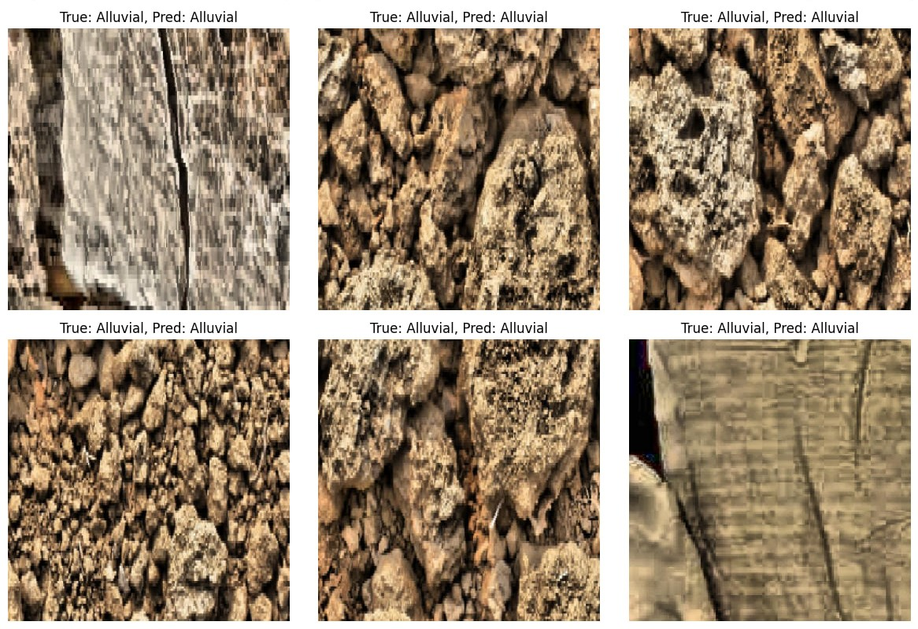

Slide 20
Contributions
Team Progress and Movement
Dataset Collection
Data labelling and Annotation
Model Training
Testing
Individual Contribution
Key contributions: Ramireddygari Yaswanth Reddy
Data Labelling
Data Collection
Key contributions: Tadipathri Syed Faiz Ali
Model Training
Testing
Key contributions: Mallu Rameshwara Reddy
Model Training
Testing

Slide 21
Conclusion & Future Work
Conclusion
In this project, we built an image classification model using EfficientNet, enhanced with data augmentation and fine-tuned for high performance. Along the way, we tackled common challenges like overfitting and class imbalance, ensuring the model stayed reliable across a variety of datasets. The results—high accuracy, precision, and recall—show that the model is ready for real-world applications.
Future Work
Expanding Datasets
One of the critical next steps is expanding the dataset to include more diverse and representative soil samples. The current dataset has limitations, which may impact the model’s generalizability. Collecting more extensive soil images across various regions, seasons, and conditions will improve the model’s ability to handle diverse scenarios and enhance its robustness.
Improving Accuracy and Precision
Future efforts will focus on boosting model accuracy and precision. This can be achieved through fine-tuning hyperparameters and experimenting with alternative architectures. Additionally, employing more sophisticated data augmentation techniques will ensure better generalization and improved prediction performance.
Integration with IoT for Real-Time Data
A major future goal is to integrate the system with IoT devices to enable real-time data collection and analysis. This could empower farmers to receive instant soil and crop recommendations, significantly enhancing decision-making on the field. Real-time IoT integration will open up new possibilities for autonomous monitoring and intelligent farming systems.

Slide 22

THANK YOU

